Slide 1


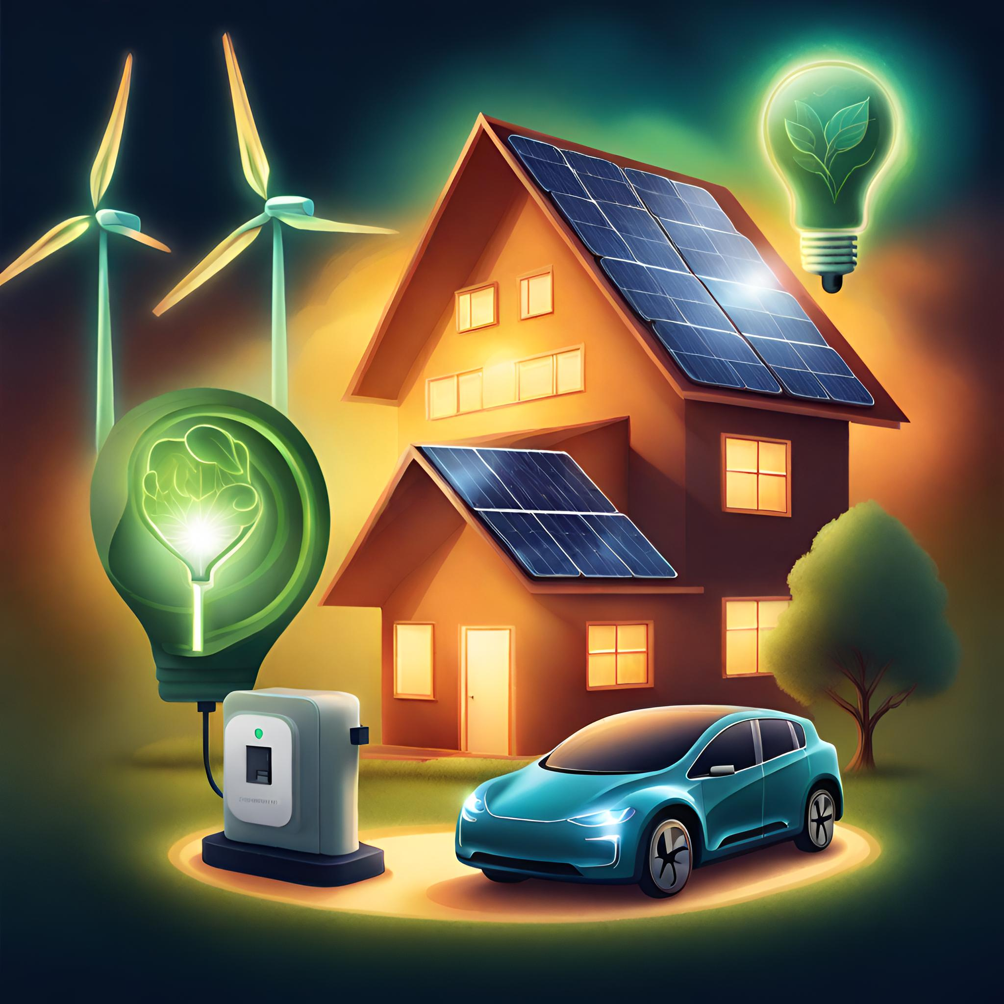
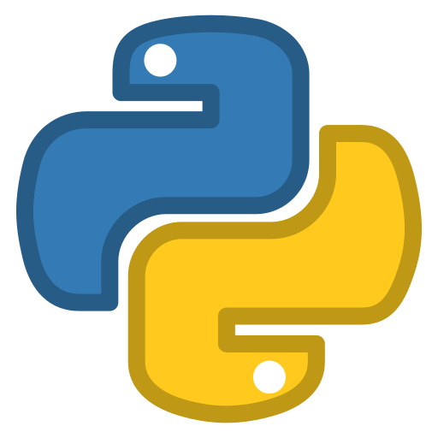
Python Refresher for Sustainable Energy Management Module
Generated by AI with Canva

Slide 2


Generated by AI with Canva
Workshop Outline
Introduction to Python
Python in the Sustainable Energy Industry
Getting Started with Python
Python Basics
Installing Python on your own computer
Jupyter Notebook Installation
What is Python
Why Python for Sustainable Energy Management?
Python Learning Resources
Python Installation
How to use google Colab
Python Refresher for Sustainable Energy Management Module

Slide 3

ENGG40341 Page on NOW Learning room:
All the news, required information, and related files related to the module will be posted on the NOW learning room of this module (https://now.ntu.ac.uk/). Please check it regularly.
Python Refresher for Sustainable Energy Management Module
3

Slide 4
Introduction to Python
🐍What is Python:
High-level, general-purpose programming language.
Created by Guido van Rossum and first released in 1991.
Emphasizes readability and ease of use.
✔️Key Features:
Interpreted language: No need for compilation.
Dynamically typed: Variable types are assigned at runtime.
Object-oriented: Supports object-oriented programming principles.
Versatile: Used for optimisation, data visualization, web development, data analysis, artificial intelligence, automation, and more.
⚖️Syntax:
Easy to read, with clear and expressive syntax.
Uses indentation (whitespace) for code blocks, eliminating the need for braces{}.
Python Refresher for Sustainable Energy Management Module
4

Slide 5
Introduction to Python
Why Python for Sustainable Energy Management?
📖Readability and Ease of Learning:
Python's clear and readable syntax makes it accessible to beginners and experts.
This is particularly beneficial in the energy sector, where professionals may have diverse backgrounds.
🧑‍🏭Rapid Prototyping and Development:
Python allows for quick development of prototypes and applications, which is essential for the dynamic and evolving field of sustainable energy management.
This rapid prototyping capability accelerates the testing and implementation of new ideas and solutions.
📑Extensive Libraries and Frameworks:
Python has a rich ecosystem of libraries and frameworks that support various aspects of sustainable energy management.
Libraries like Pandas and NumPy are valuable for data analysis and manipulation, while libraries like TensorFlow and PyTorch are essential for machine learning applications in energy forecasting.
Generated by AI with Canva
Python Refresher for Sustainable Energy Management Module
5

Slide 6

Introduction to Python
Why Python for Sustainable Energy Management?
Generated by AI with Canva
📈Data Analysis and Visualization:
Python is widely used for data analysis, an integral part of energy management.
Libraries such as Matplotlib and Seaborn facilitate the visualization of energy consumption patterns, enabling better decision-making.
🏭Interoperability and Integration:
Python can seamlessly integrate with existing systems and technologies, fostering interoperability.
This is crucial in the energy sector, where diverse systems (e.g., IoT devices, sensors, SCADA systems) need to work together for effective energy management.
📉Machine Learning for Energy Forecasting:
Python's popularity in the machine learning community, coupled with powerful libraries like scikit-learn, enables the development of models for energy consumption forecasting.
Machine learning algorithms can help optimize energy usage, improve efficiency, and contribute to sustainability goals.
Python Refresher for Sustainable Energy Management Module
6

Slide 7
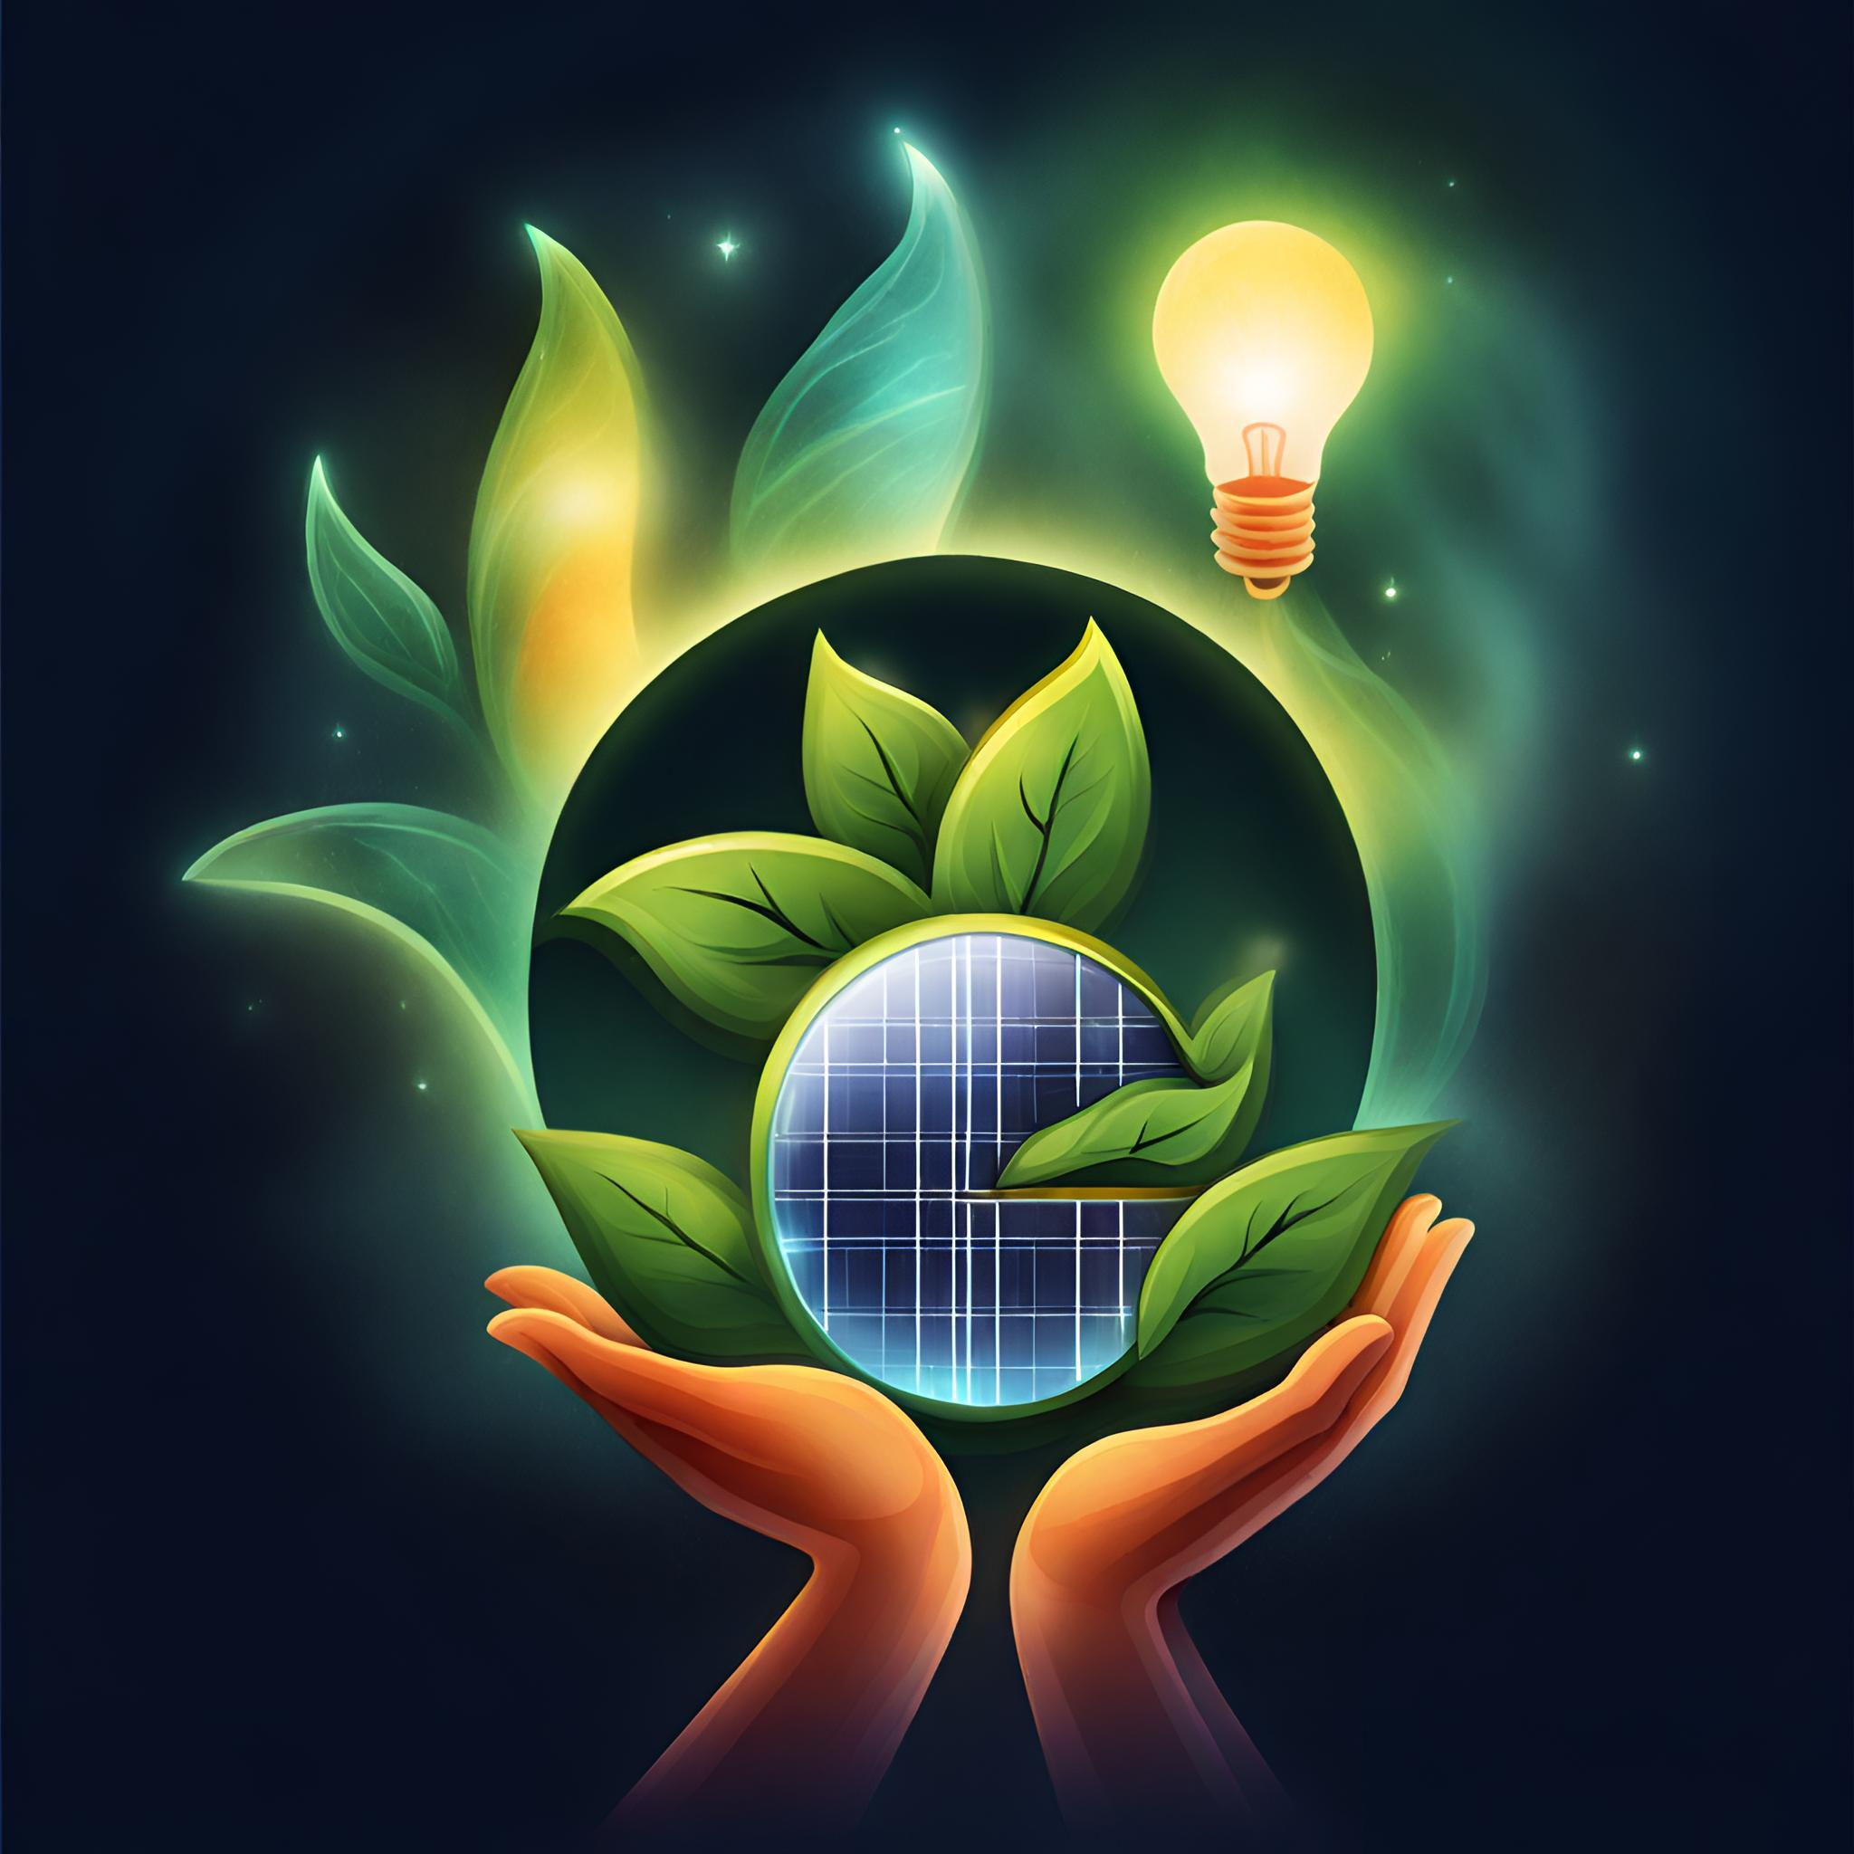
Introduction to Python
Why Python for Sustainable Energy Management?
Generated by AI with Canva
🤝Community Support and Collaboration:
Python has a large and active community that contributes to the development of tools and solutions for various domains, including sustainable energy.
The availability of open-source projects and collaborative platforms fosters knowledge sharing and innovation.
💻Flexibility and Scalability:
Python's flexibility allows for the development of scalable applications that can adapt to the changing needs of sustainable energy management.
It can be used for small-scale projects as well as large, enterprise-level applications.
⚡Remote Monitoring and Control:
Python supports the development of applications for remote monitoring and control of energy systems.
This is essential for managing distributed energy resources and ensuring efficient energy usage across various locations.
Python Refresher for Sustainable Energy Management Module
7

Slide 8





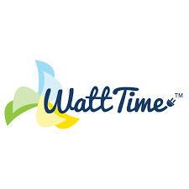


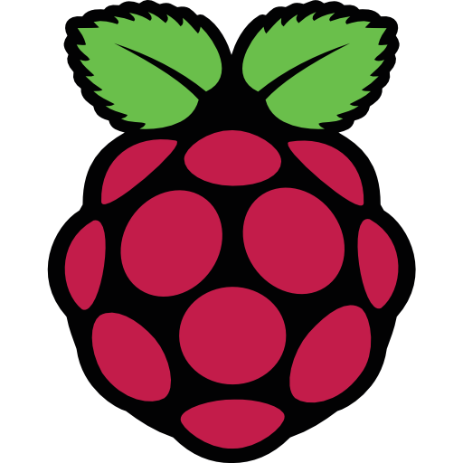
Introduction to Python
Python in the Sustainable Energy Applications
Generated by AI with Canva
Python Refresher for Sustainable Energy Management Module
8

Slide 9
Introduction to Python
Python in the Sustainable Energy Applications
Open Energy Data Initiative (OEDI):
OEDI aims to provide access to a wide range of energy-related datasets. Python is often used for data analysis and visualization within this initiative.
Emoncms:
Emoncms is an open-source energy monitoring platform. Python is often used for data analysis and visualization in projects that involve Emoncms.
WattTime:
WattTime is a nonprofit that provides software tools for measuring the environmental impact of electricity use. Python is used for data analysis and developing algorithms to determine the carbon intensity of electricity.
EnergyHub:
EnergyHub uses Python for its platform that enables utilities to manage distributed energy resources (DERs). Python is employed for data processing, analysis, and optimization.
PVlib Python:
PVlib Python is a library for modeling solar energy generation. It provides tools for simulating the performance of photovoltaic systems, and it's widely used in the renewable energy sector.
Python Refresher for Sustainable Energy Management Module
9

Slide 10
Introduction to Python
Python in the Sustainable Energy Applications
Wind Energy Python Library (WindyPy):
WindyPy is a Python library for wind energy analysis. It provides tools for working with wind data and assessing the feasibility of wind energy projects.
HOMER (Hybrid Optimization Model for Multiple Energy Resources):
While HOMER itself is written in Java, Python is often used in conjunction for data analysis and visualization. HOMER is used for designing and optimizing off-grid and microgrid energy systems.
RPI-EEM:
EnerPi is a project that combines Raspberry Pi with Python to monitor energy consumption. It's often used for home energy management and education about sustainable practices.
Your own project💡:
Dive into the world of Python with a grin, because once you've got the hang of it, you'll be the captain of your sustainable energy ship! Unleash your creativity and start running projects that make the world a brighter💡 (and greener🍃) place!
Python Refresher for Sustainable Energy Management Module
10

Slide 11
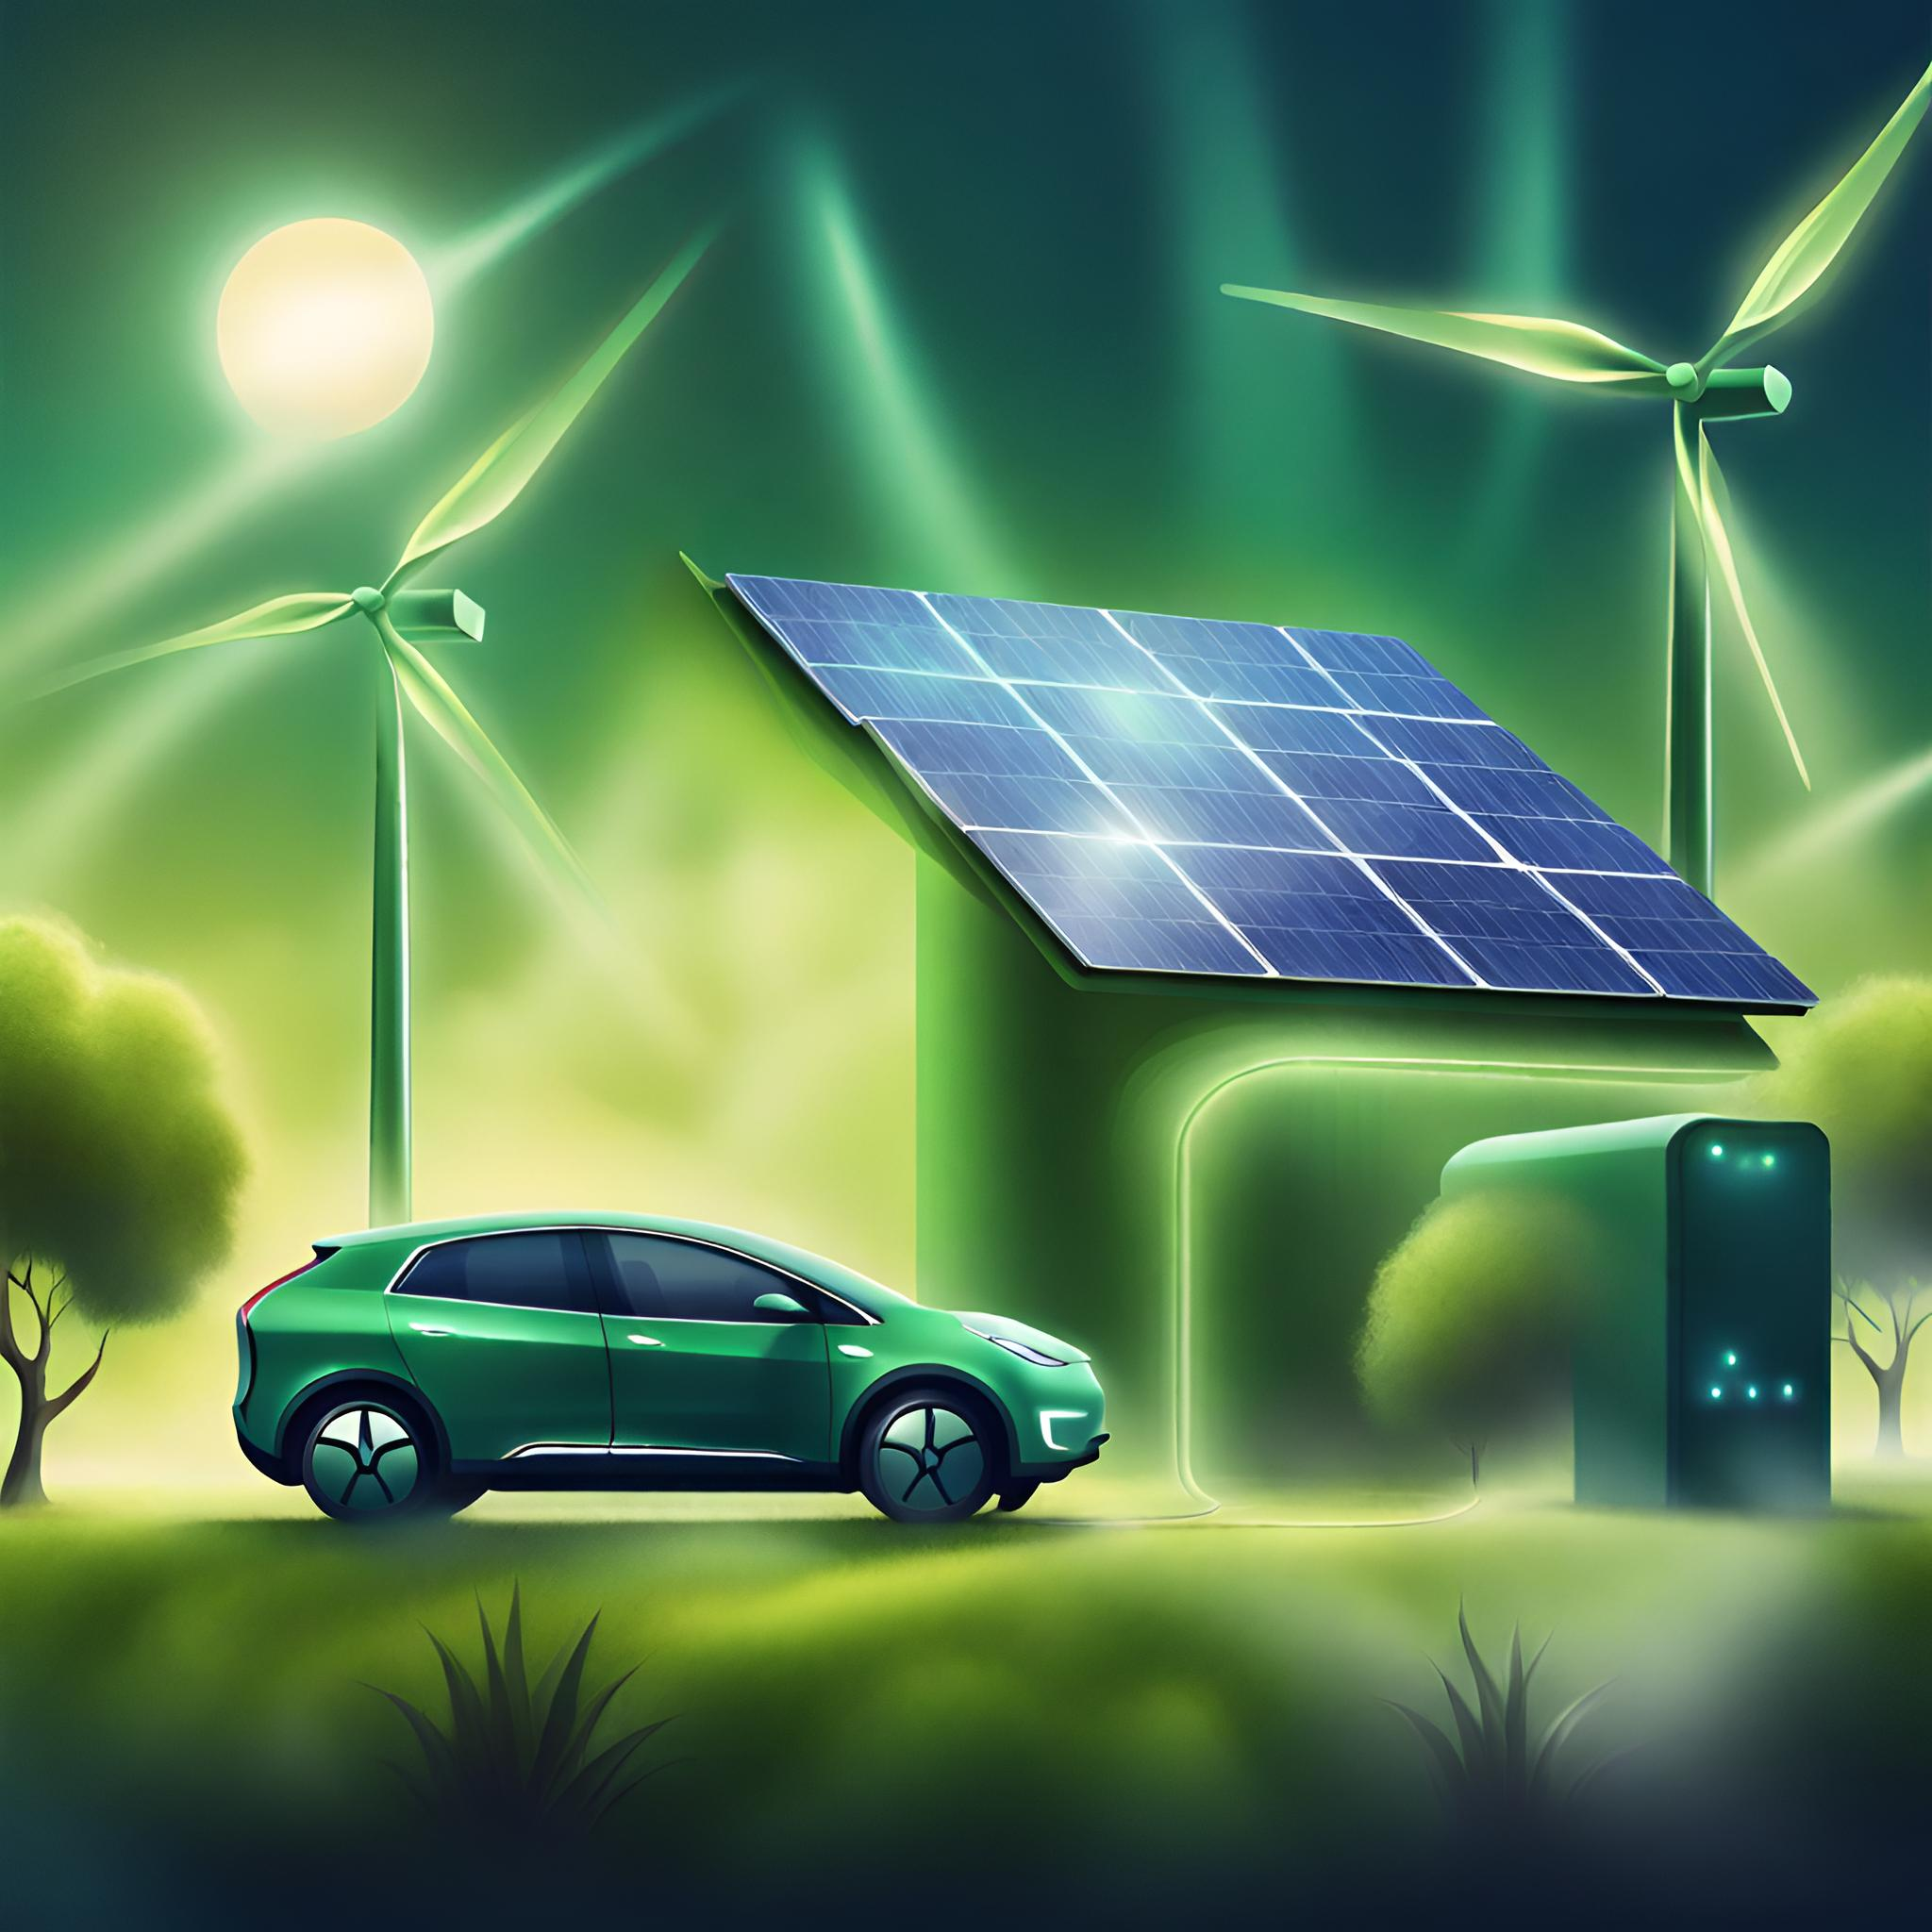
Installing Python on your own computer
Generated by AI with Canva
Python Refresher for Sustainable Energy Management Module

Slide 12
Getting Started with Python: Installing Python on your own computer
Python Versions and Releases🖥️
The first step toward Python programming is Python installation for installation we need to know which version to install.
Python has 2 versions Python3 and Python2. Python2 is not supported anymore and is a bit different from Python3 in some syntaxes and Python3 include a wide range of libraries so for integrity during the course we use Python3.
You can see the latest Python3 releases inside the Python website in the download section:
https://www.python.org/downloads/
Python Refresher for Sustainable Energy Management Module
12

Slide 13
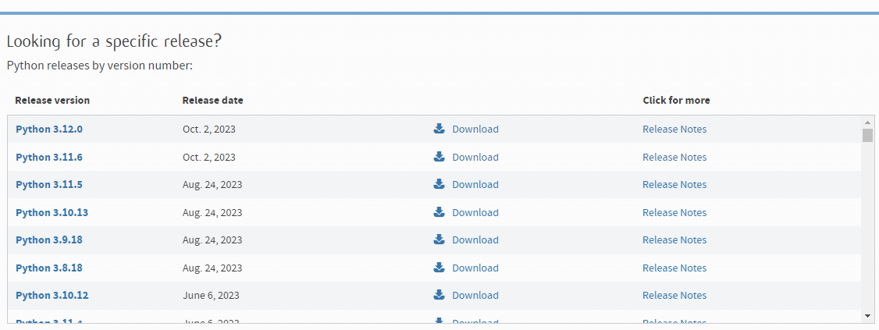
Getting Started with Python: Installing Python on your own computer
Python Versions and Releases🖥️
As you can see inside the website there are many Python versions here the latest one is 3.12 we recommend using the latest release because normally the last release has a wide range of functionalities and improvements.
At this time the latest one is 3.12 and we use Python 3.12 during the course and recommend you use this version.
Python Programming For Sustainable Energy Management
13

Slide 14

Getting Started with Python: Installing Python on your own computer
Python Installation🖥️
Installing Python on Mac, Windows, and Linux involves slightly different steps due to the variations in operating systems. Below are the general instructions for each:
Installing Python on Windows:
Download Python:
Visit the official Python website: Python Downloads.
Click on the "Downloads" tab, and select the latest version of Python for Windows(3.12).
Run Installer:
Once the installer is downloaded, run the executable file (it will be named something like python-3.x.x.exe).
Check the box that says "Add Python to PATH" during the installation.
Installation Wizard:
Follow the instructions in the Python Installation Wizard.
Verify Installation:
Open a command prompt or PowerShell or CMD and type `python --version` or `python –V` to verify that Python is installed. In some cases, if you have another Python installation you have to
Python Programming For Sustainable Energy Management
14

Slide 15
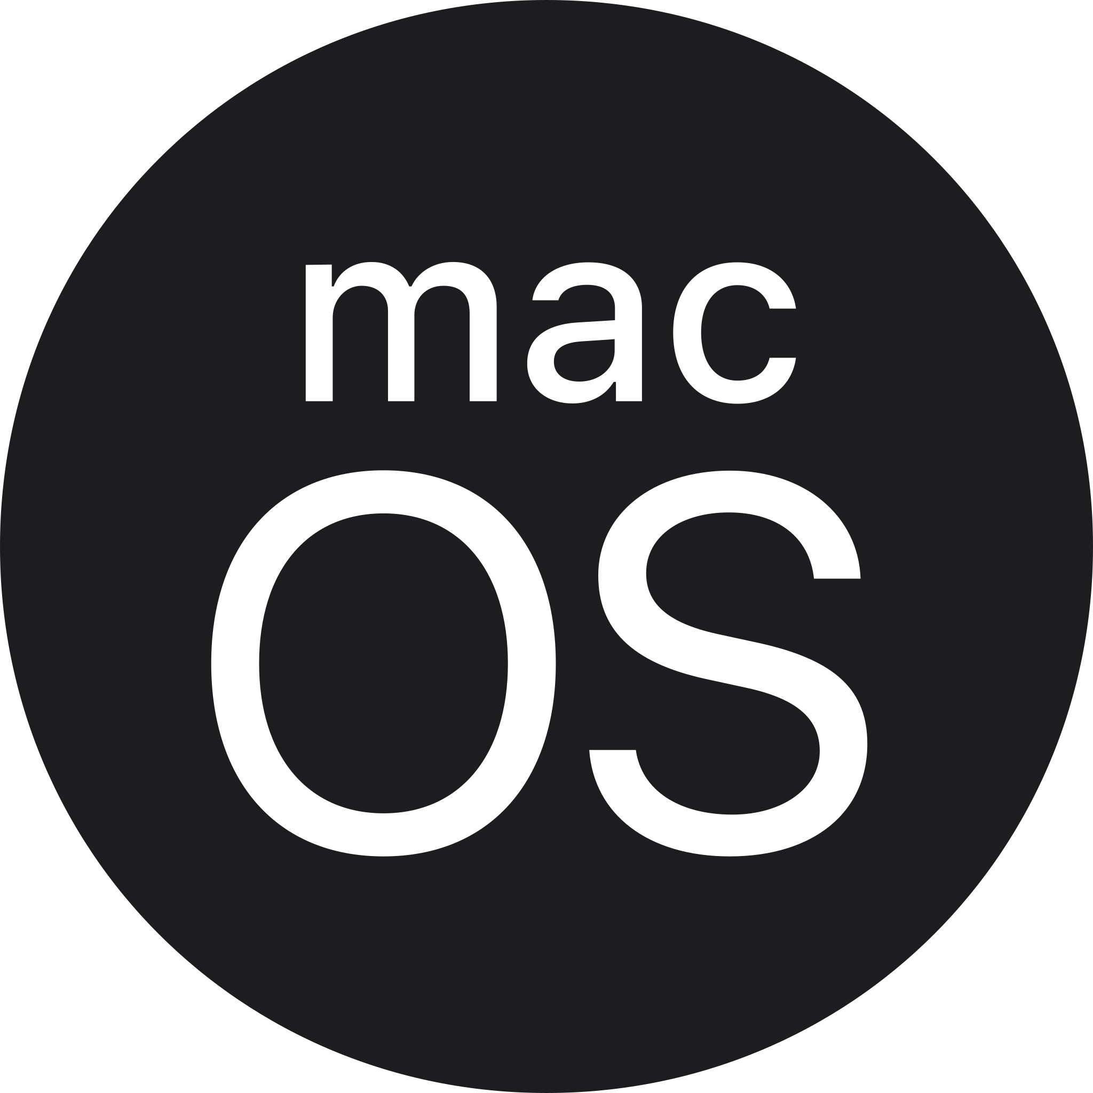
Getting Started with Python: Installing Python on your own computer
Python Installation🖥️
Installing Python on macOS:
Download Python:
Visit the official Python website: Python Downloads.
Click on the "Downloads" tab, and select the latest version of Python for macOS.
Run Installer:
Once the installer is downloaded, run the package file (it will be named something like python-3.x.x-macosx10.x.pkg).
Installation Wizard:
Follow the instructions in the Python Installation Wizard.
Verify Installation:
Open the Terminal and type ‘python3 –version’ to verify that Python is installed.
Python Programming For Sustainable Energy Management
15

Slide 16
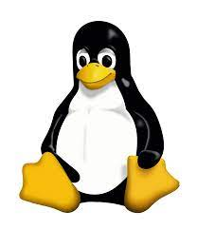
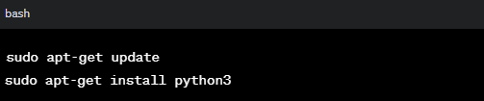
Getting Started with Python: Installing Python on your own computer
Python Installation🖥️
Installing Python on Linux:
Check Python Version:
Many Linux distributions come with Python pre-installed.
Open a terminal and type `python3 –version` or `python –version` to check the version.
Install Python:
If Python is not installed, you can use your package manager to install it. For example, on Ubuntu, you can use:
Verify Installation:
Type `python3 –version` or `python –version` to verify the installation.
⚡Do not type` inside terminal just python3 –version !
Python Programming For Sustainable Energy Management
16

Slide 17

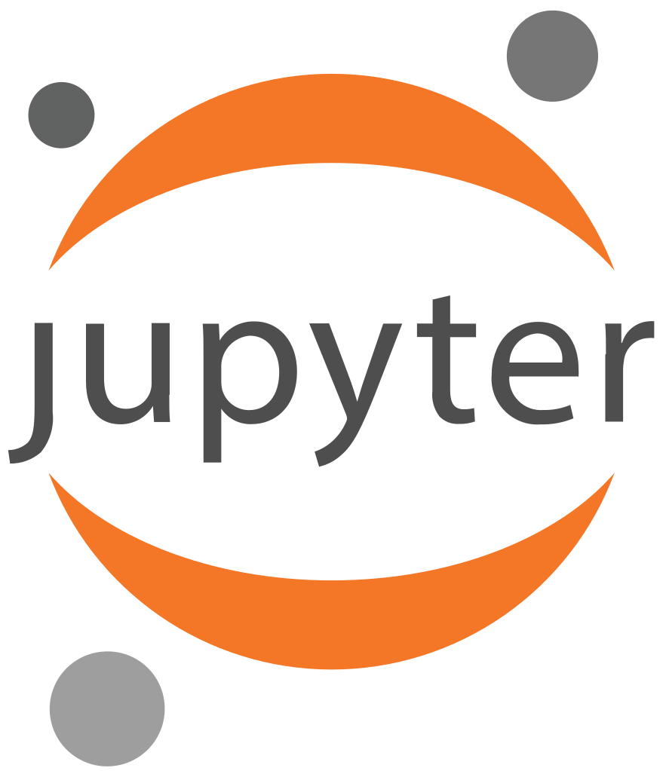
Python and Jupyter Installation on your own Laptop📽️Video Tutorial (Windows)
Link to access video:
⚠️ Python and Jupyter Installation 📽️Video Tutorial (Windows)
We're excited to share that we've created a video tutorial exclusively for installing Python and Jupyteron on your own laptop and on Windows OS.
This video simplifies the installation process, ensuring a smooth setup for Python beginners.
Check it out in the Now Materials for step-by-step guidance and tips on using Python effortlessly. Happy coding!😉🧑‍💻
Python Refresher for Sustainable Energy Management Module
17

Slide 18
Jupyter Notebook Installation
Generated by AI with Canva
Python Refresher for Sustainable Energy Management Module

Slide 19
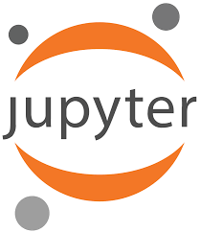
Getting Started with Python
How to use the installed Python⁉️:
Python is based on scripts you can use your computer command line to write down scripts and see the outputs, as it may be hard to deal with the command line interface on Windows or console on Linux, there are many advanced IDEs developed for using Python, one of the easy use interfaces for using python is Jupiter notebook, Jupiter notebook give you a web interface for writing your codes in web browser environment and we use Jupiter during our Python Programming sessions. In the next slides we give you the instructions for installing Jupyter Notebook and how to run your first Python code🐍⌨️💻
Let’s start to install Jupyter Notebook
Python Refresher for Sustainable Energy Management Module
19

Slide 20
Getting Started with Python
Jupyter Notebook Installation🖥️
Installing Jupyter on Mac, Windows, and Linux involves slightly different steps due to the variations in operating systems. Below are the general instructions for each:
Installing Jupiter Notebook on Windows:
Open Command Prompt:
Push Windows+R button and type cmd and click OK or (you can search for "cmd" in the Start menu and Run command prompt application).
Install Jupyter using pip:
In the Command Prompt, type the following command and press Enter to install Jupyter using the Python package manager, pip: (Do not type ` ` inside the command prompt!)
`pip install jupyter`
Verify Installation:
After the installation is complete, you can verify it by typing:
`jupyter notebook`
This command should open a new tab in your default web browser with the Jupyter Notebook interface.
Python Refresher for Sustainable Energy Management Module
20

Slide 21
Getting Started with Python
Jupyter Notebook Installation🖥️
Installing Jupyter on Mac, Windows, and Linux involves slightly different steps due to the variations in operating systems. Below are the general instructions for each:
Installing Jupiter Notebook on Windows:
Create a Jupyter Notebook:
In the Jupyter Notebook interface, you can create a new notebook by clicking on "New" and selecting "Python 3" (or any other available kernel).
Python Refresher for Sustainable Energy Management Module
21

Slide 22
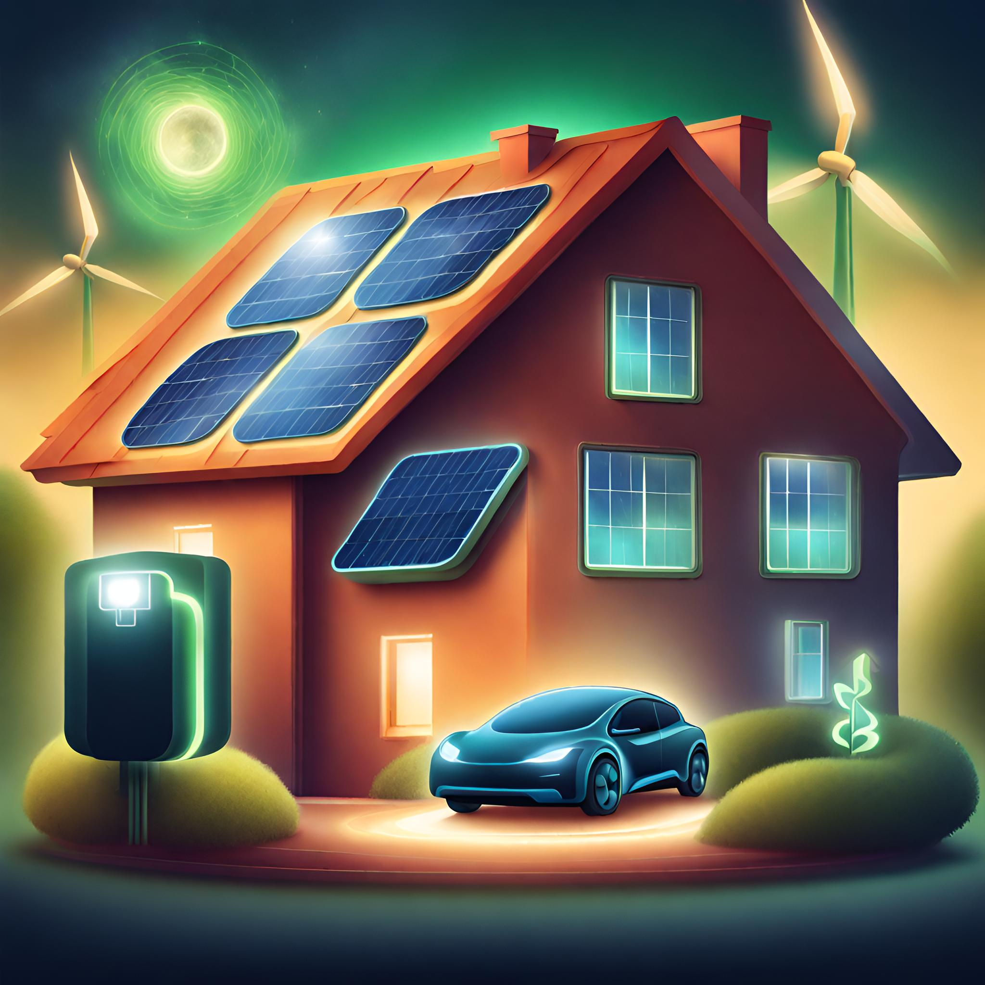

How To Use Google Colab
Generated by AI with Canva
Python Refresher for Sustainable Energy Management Module

Slide 23
How To Use Google Colab
What is Google Colab?
Google Colab, short for Colaboratory, is a free, cloud-based platform provided by Google that allows you to write and execute Python code in a web-based interactive environment
Why Using Google Colab?
If you want to access a web-based Jupyter notebook and python online without trouble of installing Jupyter notebook and python you can use google colab, maybe inside university workstations you have not appropriate permit to install or run programs so colab give you possibility to work on your own jupyer notebook from anywhere and just from a web browser!🌐
Generated by AI with Canva
Python Refresher for Sustainable Energy Management Module

Slide 24
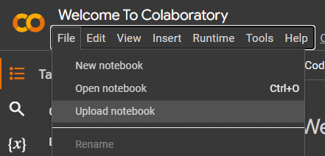
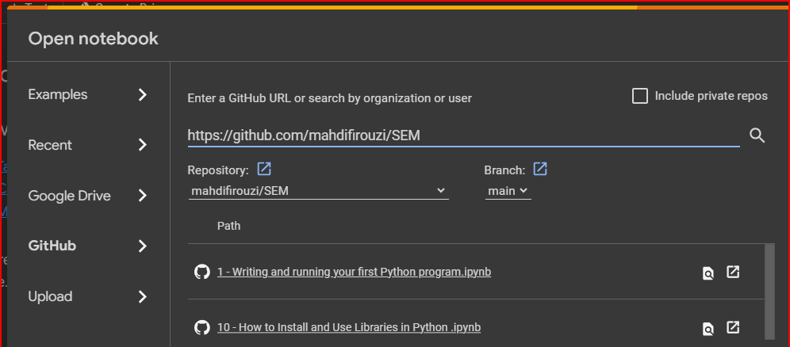
How to use Google Colab
How to Open Notebooks
Go to Google Colab Website: https://colab.research.google.com/
Click on Upload notebook and GitHub and then paste GitHub Repository address
(https://github.com/mahdifirouzi/SEM) On the search bar and click on search
Then you can Open the notebooks inside GitHub Repository you also can upload an
Ipython file from your computer inside Upload section and open it inside colab:
Python Refresher for Sustainable Energy Management Module
24

Slide 25
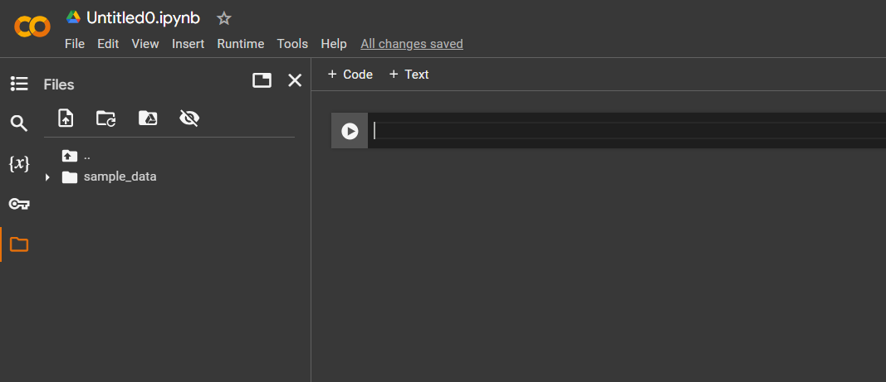
How to use Google Colab
How to use Files on Google Colab
Inside your program sometimes you need to read or write into a file to access specific data or save the data in this regard you have to upload files inside colab to use them inside your program.
Open files to see the files by clicking on the folder icon:
You can upload the files here or clone files from a GitHub repository.
Python Refresher for Sustainable Energy Management Module
25

Slide 26
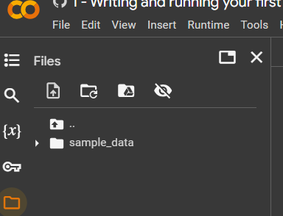
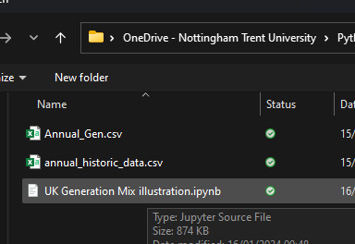
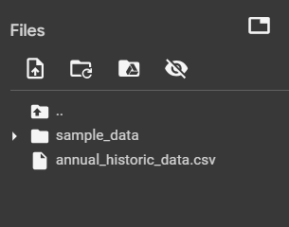
How to use Google Colab
How to Upload Files on Google Colab
Click on Upload icon
Then select the file from your computer
Click on refresh icon
Then you can see your file is uploaded
Python Refresher for Sustainable Energy Management Module
26

Slide 27
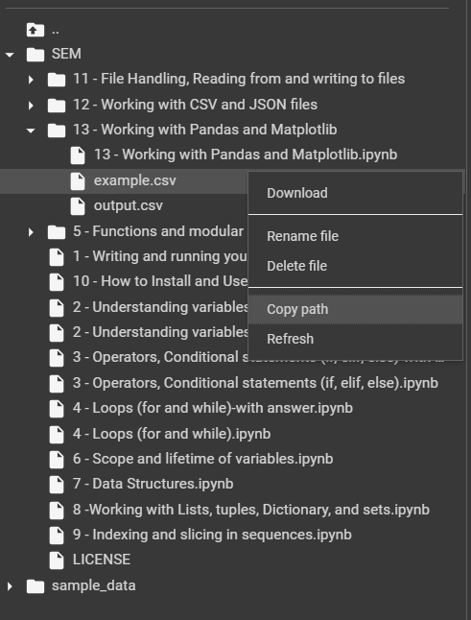
How to use Google Colab
How to use Files on Google Colab
You can Use Copy path for using that files inside your program
For this example the path is:
/content/SEM/13 - Working with Pandas and Matplotlib/example.csv
Python Refresher for Sustainable Energy Management Module
27

Slide 28
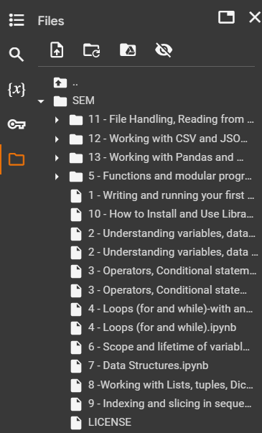
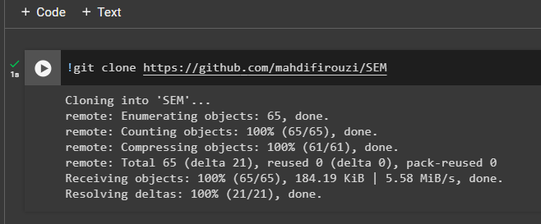
How to use Google Colab
How to Clone a GitHub repository to Google Colab
Type this code to get ipython files from GitHub: !git clone https://github.com/mahdifirouzi/SEM
And run it to get the files from GitHub
After Completion of Cloning you can see your files inside file explorer
This files can not be opened just you can make use of them inside your program
Python Refresher for Sustainable Energy Management Module
28

Slide 29
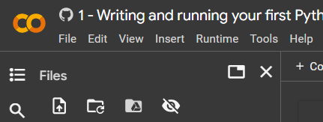
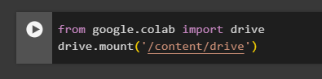
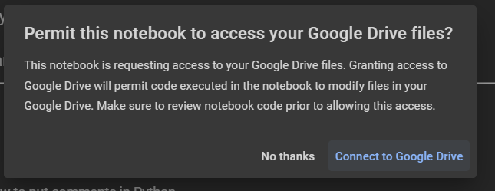
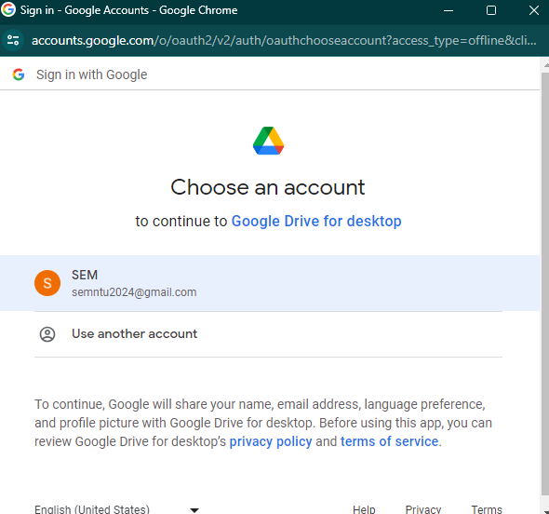
How to use Google Colab
How to use Mount Google Drive Files on Google Colab
You can use google drive files during your program using your google drive for this
you can mount Google drive by click on google drive icon:
This Cell wil be appeared on your notebook and
Run it:
Click on this window:
Then give the access to your google colab files:
Python Refresher for Sustainable Energy Management Module
29

Slide 30
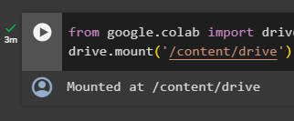
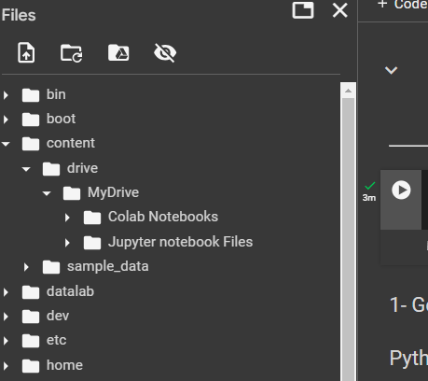
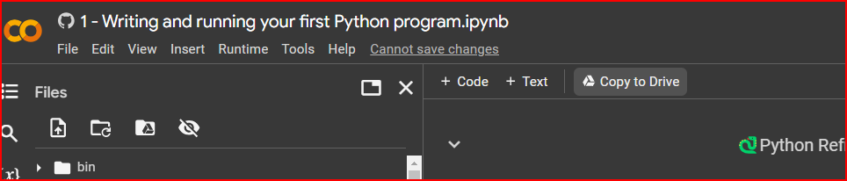
How to use Google Colab
How to use Mount Google Drive Files on Google Colab
If the mount is succesfull you can see Mounted at like this:
This Files appear inside the directory /content/drive/
You can see your saved Colab Notebooks inside the Colab Notebooks folder
By clicking on copy to drive button you can ensure you have the files saved inside
Your google Drive
Python Refresher for Sustainable Energy Management Module
30

Slide 31
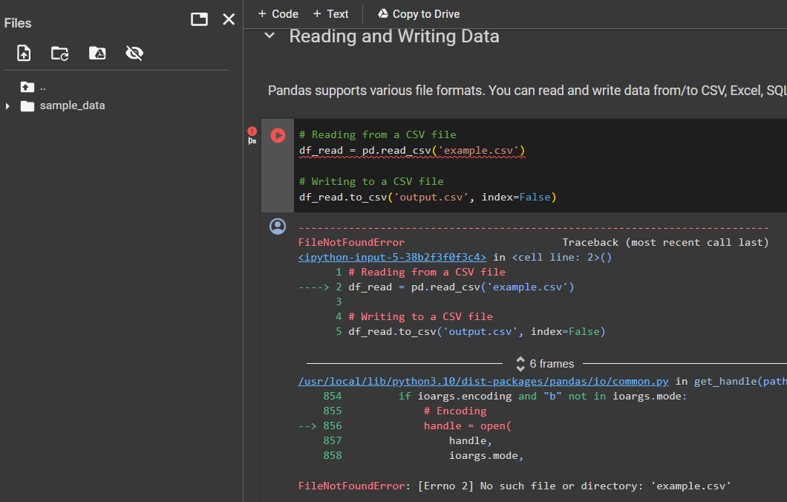
How to use Google Colab
How to change files directory to Google Colab
When using google colab the files directory is different from what you have inside your personal computer so you have to change file directories to proper one here is an example:
When I run this code I got an Error because
the example.csv file is not In my current directory,
you have to upload the file there or give the proper
Directory from the files you cloned before from Github
current directory
Python Refresher for Sustainable Energy Management Module
31

Slide 32
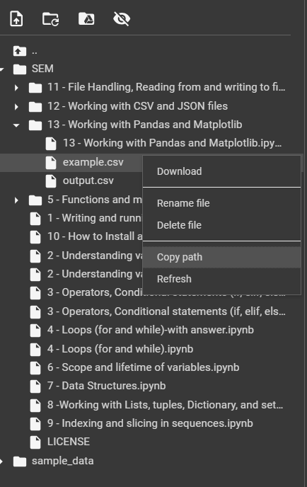
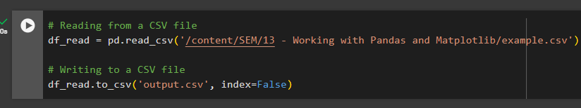
How to use Google Colab
How to change files directory to Google Colab
Now I find the file from cloned files from GitHub and copy the path:
/content/SEM/13 - Working with Pandas and Matplotlib/example.csv
Then change the path of the file inside the code:
current directory
So your code now can be executed successfully
Python Refresher for Sustainable Energy Management Module
32

Slide 33

Link to access Jupyter notebook files and Slides on Github:
33

Slide 34
Learning Resources
Generated by AI with Canva
Python Refresher for Sustainable Energy Management Module

Slide 35



Getting Started with Python
🐍Python Learning Resources
There are numerous online resources available for learning Python, like YouTube and … addressing your questions regarding Python syntax. Here are some of them:
- Python official website documentation: https://docs.python.org/3/tutorial/index.html
- Python cheatsheet website: https://www.pythoncheatsheet.org/cheatsheet/
- Today AI is so hot🔥, many of the pictures you saw in this slide was created by AI, so you can use Generative AI like ChatGPT and Google Bard:
Chatgpt: https://chat.openai.com/
Google Bard: https://bard.google.com/chat
Always consider NTU policies when using AI. You can find Dos and Don’ts in: https://www.ntu.ac.uk/studenthub/news/2023/12/artificial-intelligence-@-ntu
Python Refresher for Sustainable Energy Management Module
35

Slide 36
Python Basics
Generated by AI with Canva
Python Refresher for Sustainable Energy Management Module

Slide 37

Python Basics
Link to access Basic Python files on Now Learning Room:
🐍 Python Basics Refresher
In this section, we delve into Python basics by presenting various examples.
We provided a set of basic IPython files created for use within the class, and together, we learn how to code in Python, line by line. Additionally, you can use this files on your own to learn python step by step.
The primary objective of this class is not solely to teach Python itself; instead, we aim to review Python as a valuable tool for working with diverse datasets in sustainable energy management.
We demonstrate how Python can be effortlessly utilized to solve problems and showcase its ease of use in practical applications.
Python Refresher for Sustainable Energy Management Module
37

Slide 38
Link to access Jupyter notebook files and Slides on Github:
38

